Slide 1
iBERT Test Script in TCL

Slide 2
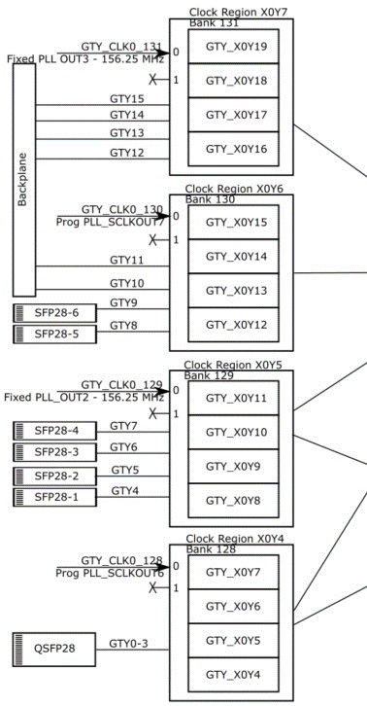
iBERT Core – Transceivers available

Slide 3
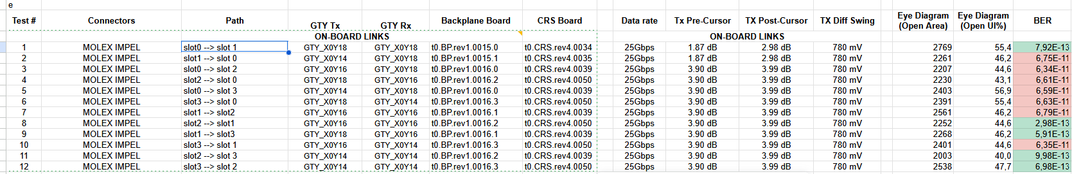
iBERT Testing – How to route the transceivers

Slide 4
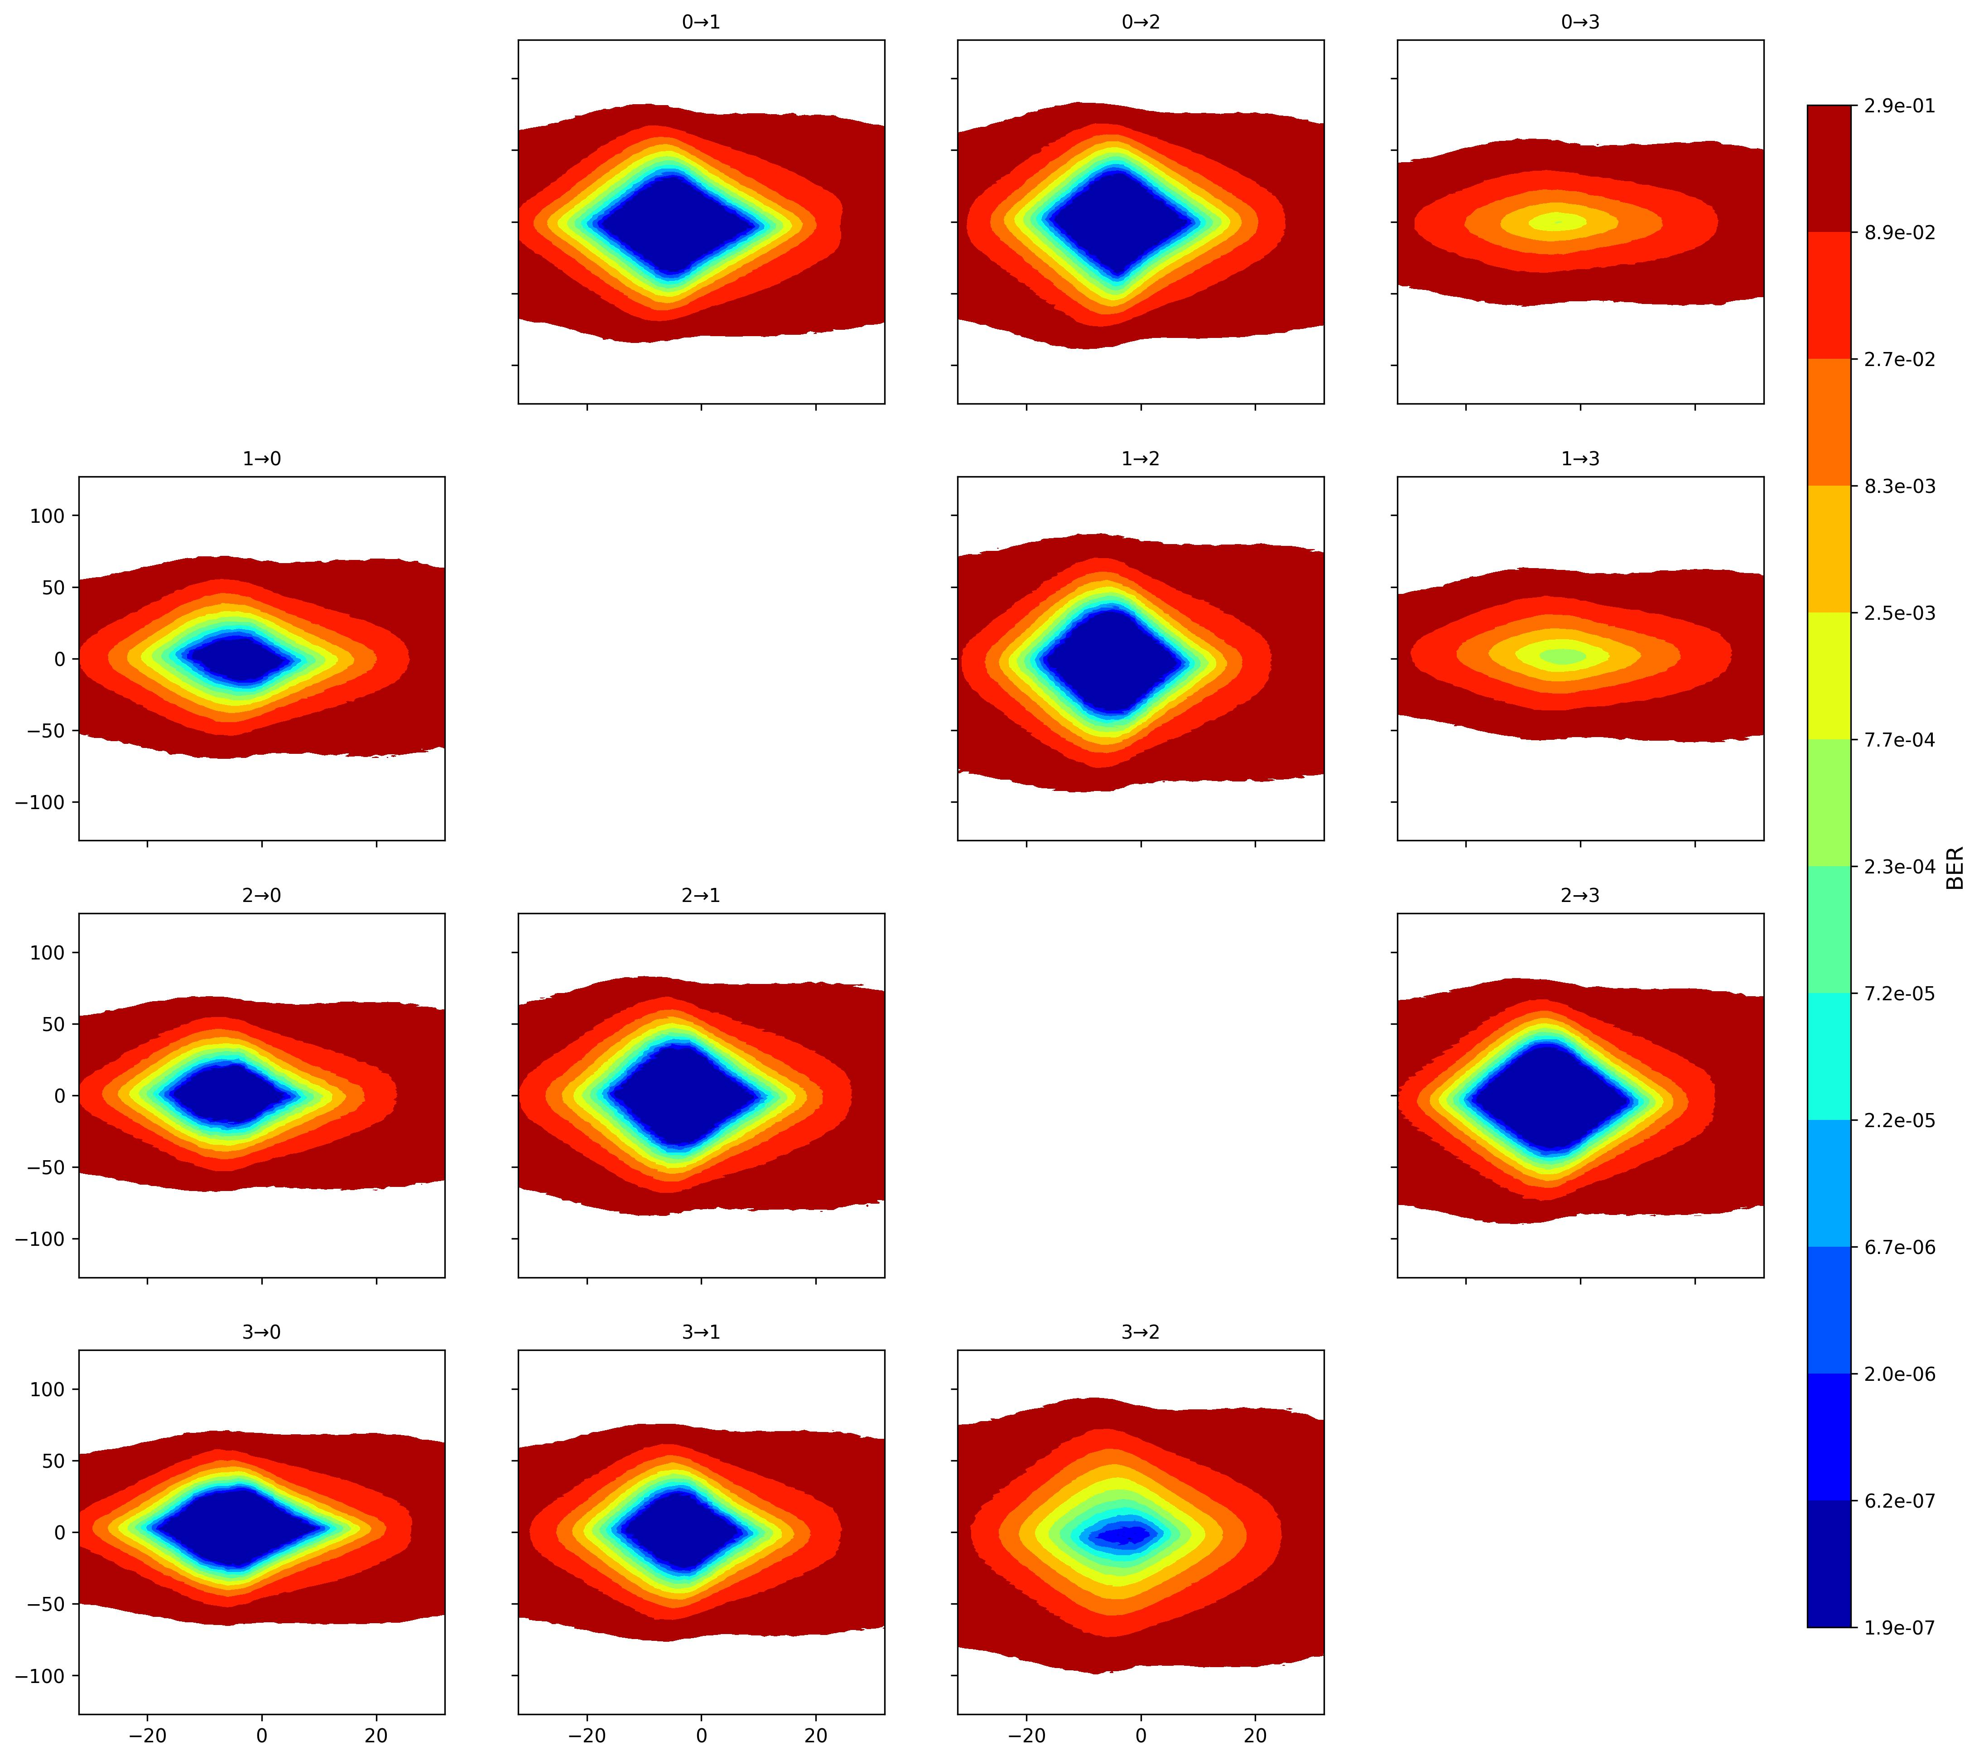
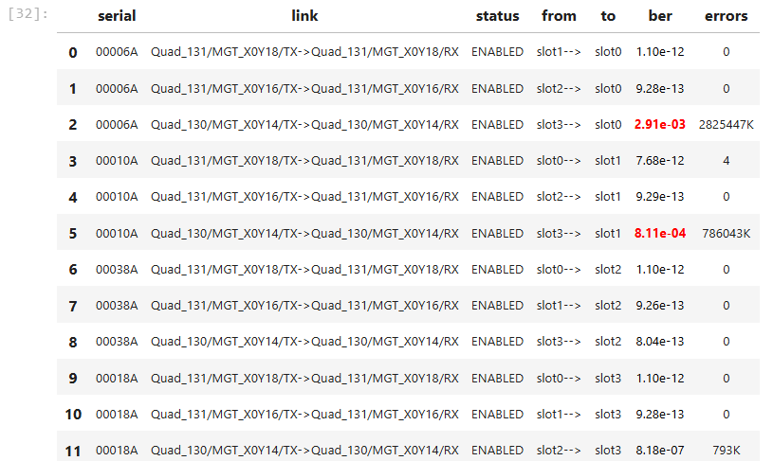
Automatized QC backplane tests – 06-22-2025
BP Board rev0
CRS rev2 – 00006A
CRS rev4 – 00038A
CRS rev2 – 00018A
CRS rev2 – 00010A
SLOT0
SLOT1
SLOT2
SLOT3
iBERT settings: PRBS 31-bit / 3.90dB TXpre / 3.99dB TXpost / TXDIFFSWING 780mV/ DFE enabled

Slide 5
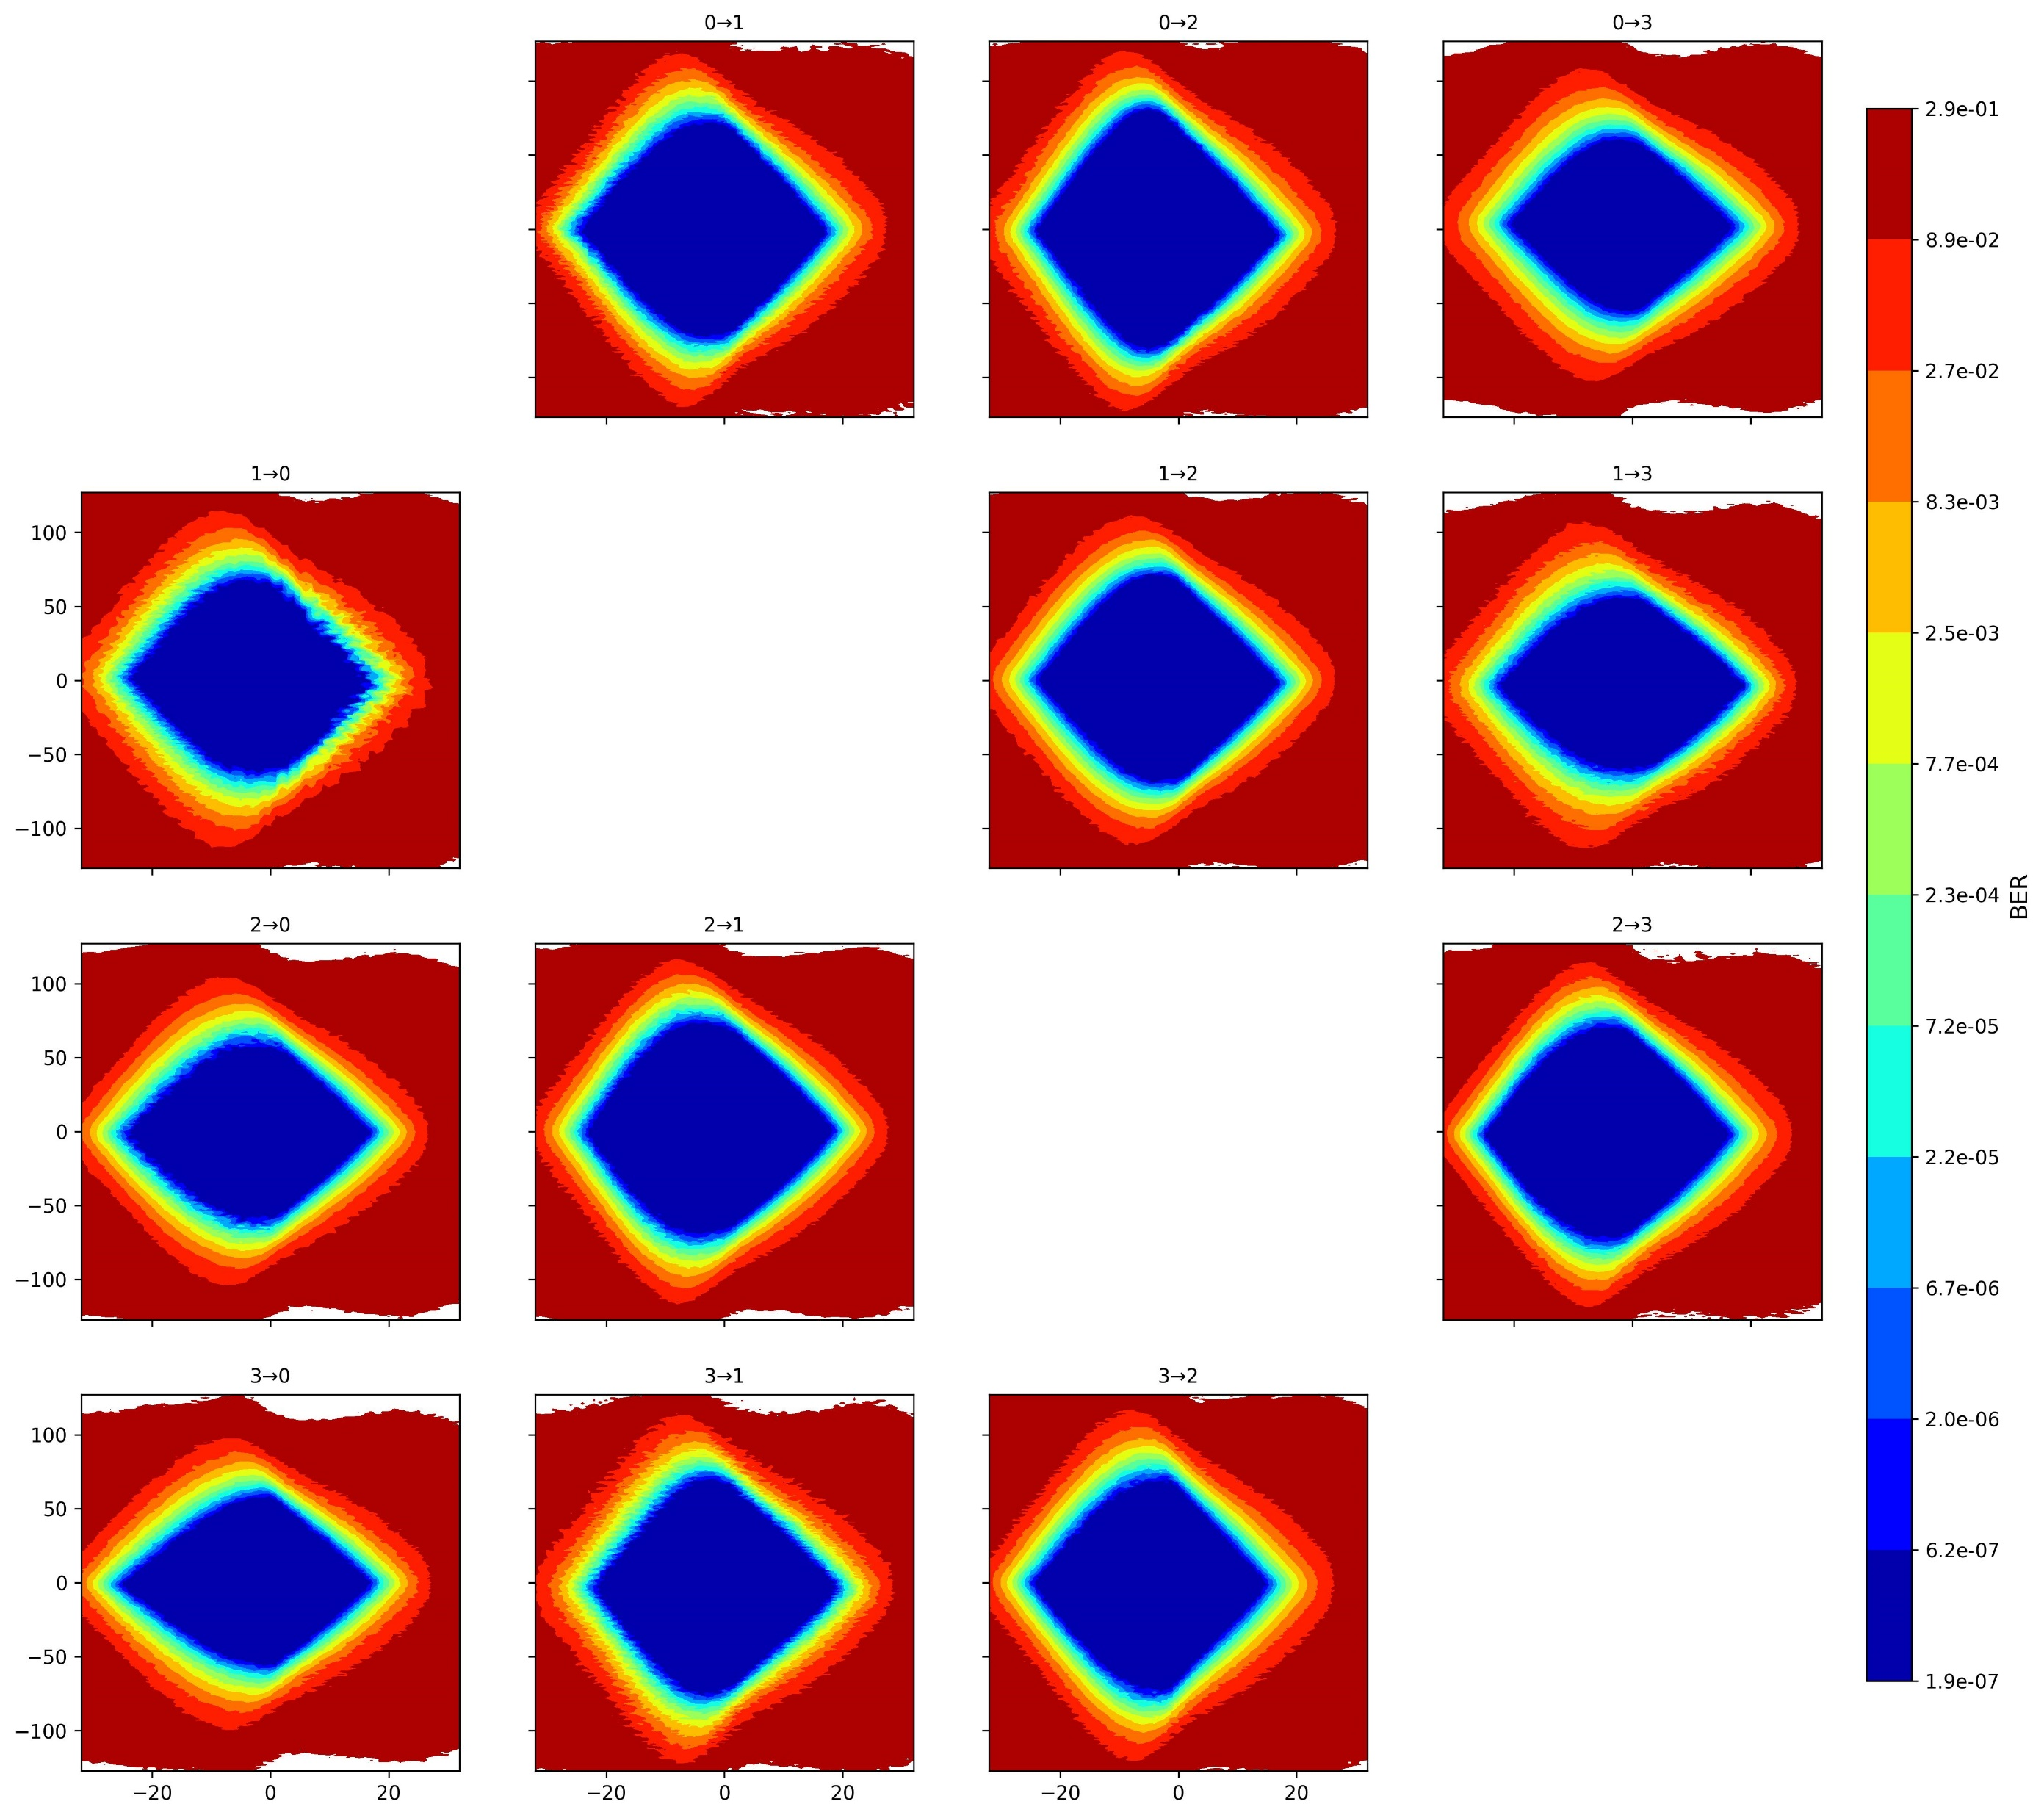
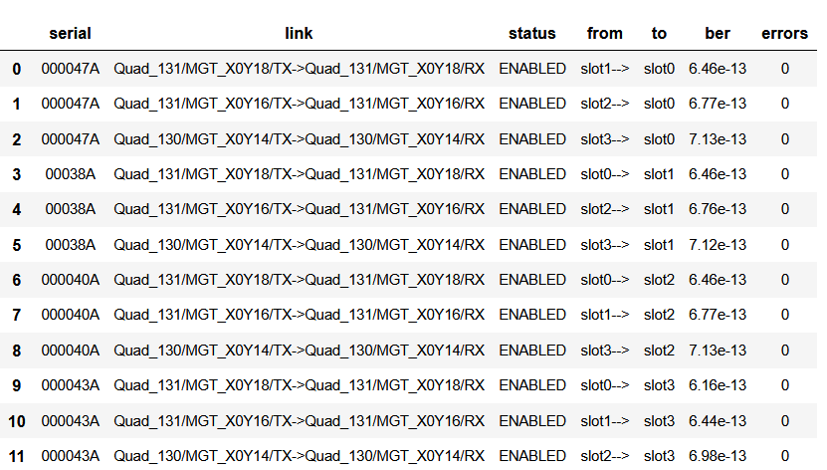
Automatized QC backplane tests – 06-25-2025
BP Board rev1
CRS rev4 – 000047A
CRS rev4 – 000040A
CRS rev4 – 000043A
CRS rev4 – 00038A
SLOT0
SLOT1
SLOT2
SLOT3
iBERT settings: PRBS 31-bit / 1.87dB TXpre / 2.98dB TXpost / TXDIFFSWING 780mV/ DFE enabled

Slide 6
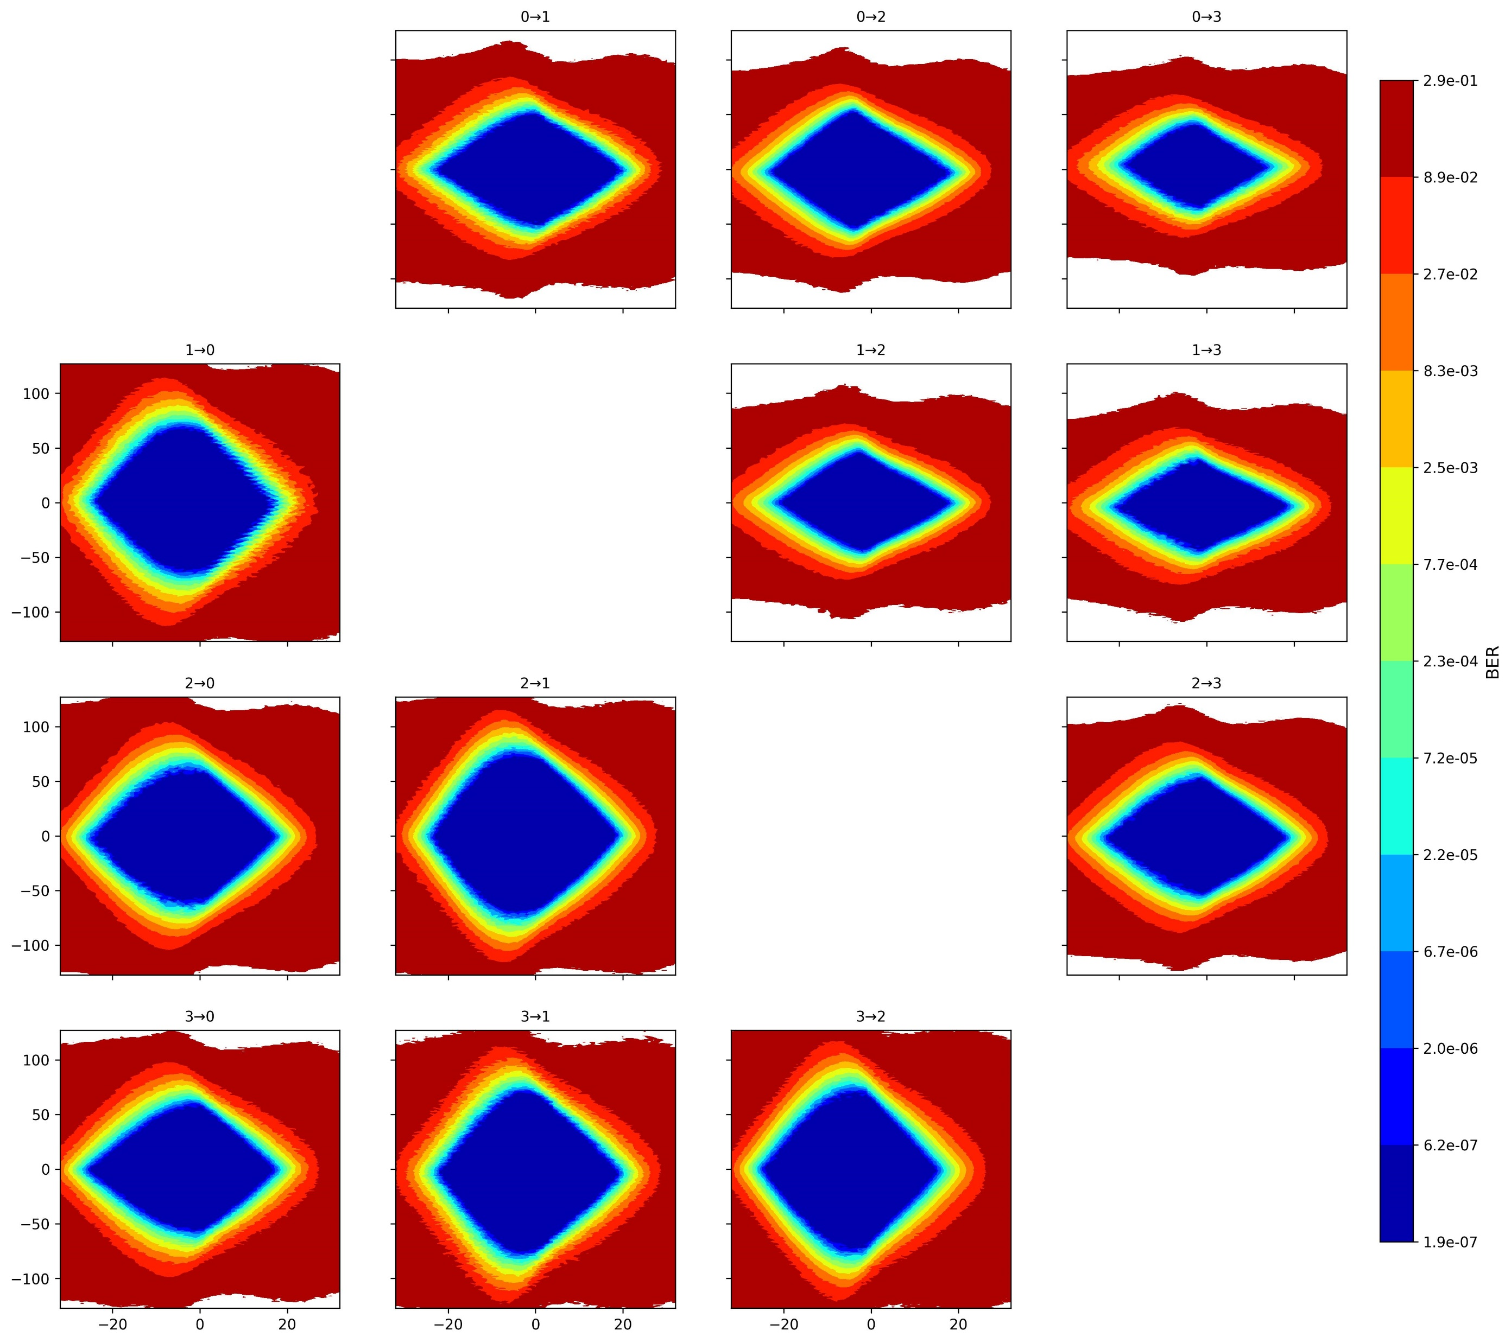
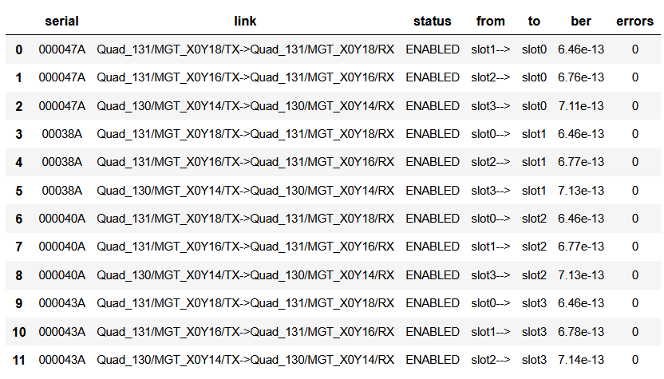
Automatized QC backplane tests – 06-25-2025
BP Board rev1
CRS rev4 – 000047A
CRS rev4 – 000040A
CRS rev4 – 000043A
CRS rev4 – 00038A
SLOT0
SLOT1
SLOT2
SLOT3
iBERT default settings: PRBS 31-bit / 0.01dB TXpre /0.00dB TXpost / TXDIFFSWING 390mV / DFE enabled

